Slide 1
Open Preservation Foundation and The Preservation Action Registry
Martin Wrigley, Executive Director, OPF

Slide 2
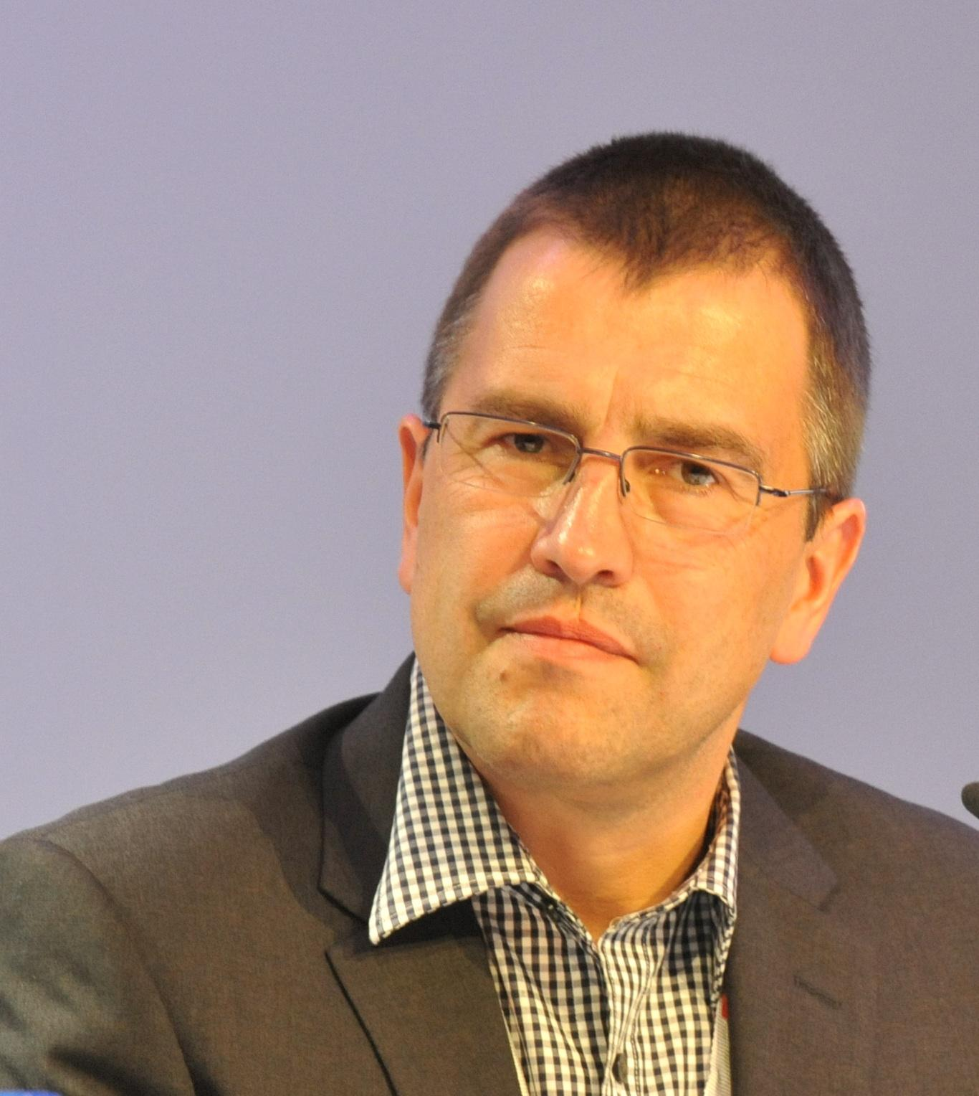
Martin Wrigley
30+ years experience delivering software and solutions - mostly in Mobile Telecoms
10+ years experience of managing a membership driven open source association
OPF Executive Director since September 2017
Expanding my knowledge of the finer points of Digital Preservation

Slide 3
Who is OPF?
A not for profit, global membership association providing stewardship of open-source tools for the digital preservation community.
Founded in 2010 to sustain the results of the EU PLANETS project
The OPF reference toolset now includes veraPDF, JHOVE and more

Slide 4
What is OPF’s purpose?
OPF Vision
Open sustainable digital preservation
OPF Mission
Enabling shared solutions for effective and efficient digital preservation; the Open Preservation Foundation leads a collaborative effort to create, maintain and develop the reference set of sustainable, open source digital preservation tools.
This set of tools (including software and standards) enables organisations to evaluate, validate, document, mitigate risk, and process digital content to be preserved in line with desired policies and community best practice.
Values
Open
Member driven
Collaborative & Inclusive
Innovative

Slide 5
Who are OPF members?
Austrian Institute of Technology British Library Bibliotheque Nationale de France Goportis
International Atomic Energy Archives Jisc Koninklijke Bibliotheek Det Kgl. Bibliotek Nationaal Archief
The National Archives UK Nasjonalbiblioteket Rigsarkivet Ex Libris Rahvusarhiiv
Latvijas Nacionala biblioteka Österreichische Nationalbibliothek
Preservica Yale University Library Albert-Ludwigs Universitat University of North Carolina Portico PSNC (Poznan Supercomputing & Networking Centre) Artefectual Biblioteca Nacional de Portugal Arcsys Software
We welcome any organisation with a mandate to preserve digital information
for the long term

Slide 6
What does OPF do?
Community Knowledge
Sharing knowledge
Develop the OPF reference toolset
Deliver to development roadmaps
Community engagement
Webinars and training
Interest Groups and Tech Clinics
OPF Software Maturity Model
Hosting community services e.g. COPTR
Website, blogs, events

Slide 7
OPF – Digital Preservation Knowledge and Tools
Knowledge – Member and Community input and sharing
Digital Preservation – Process, Policy & Best Practice
Practical Tools
- Open Source
- Reference Toolset

Slide 8
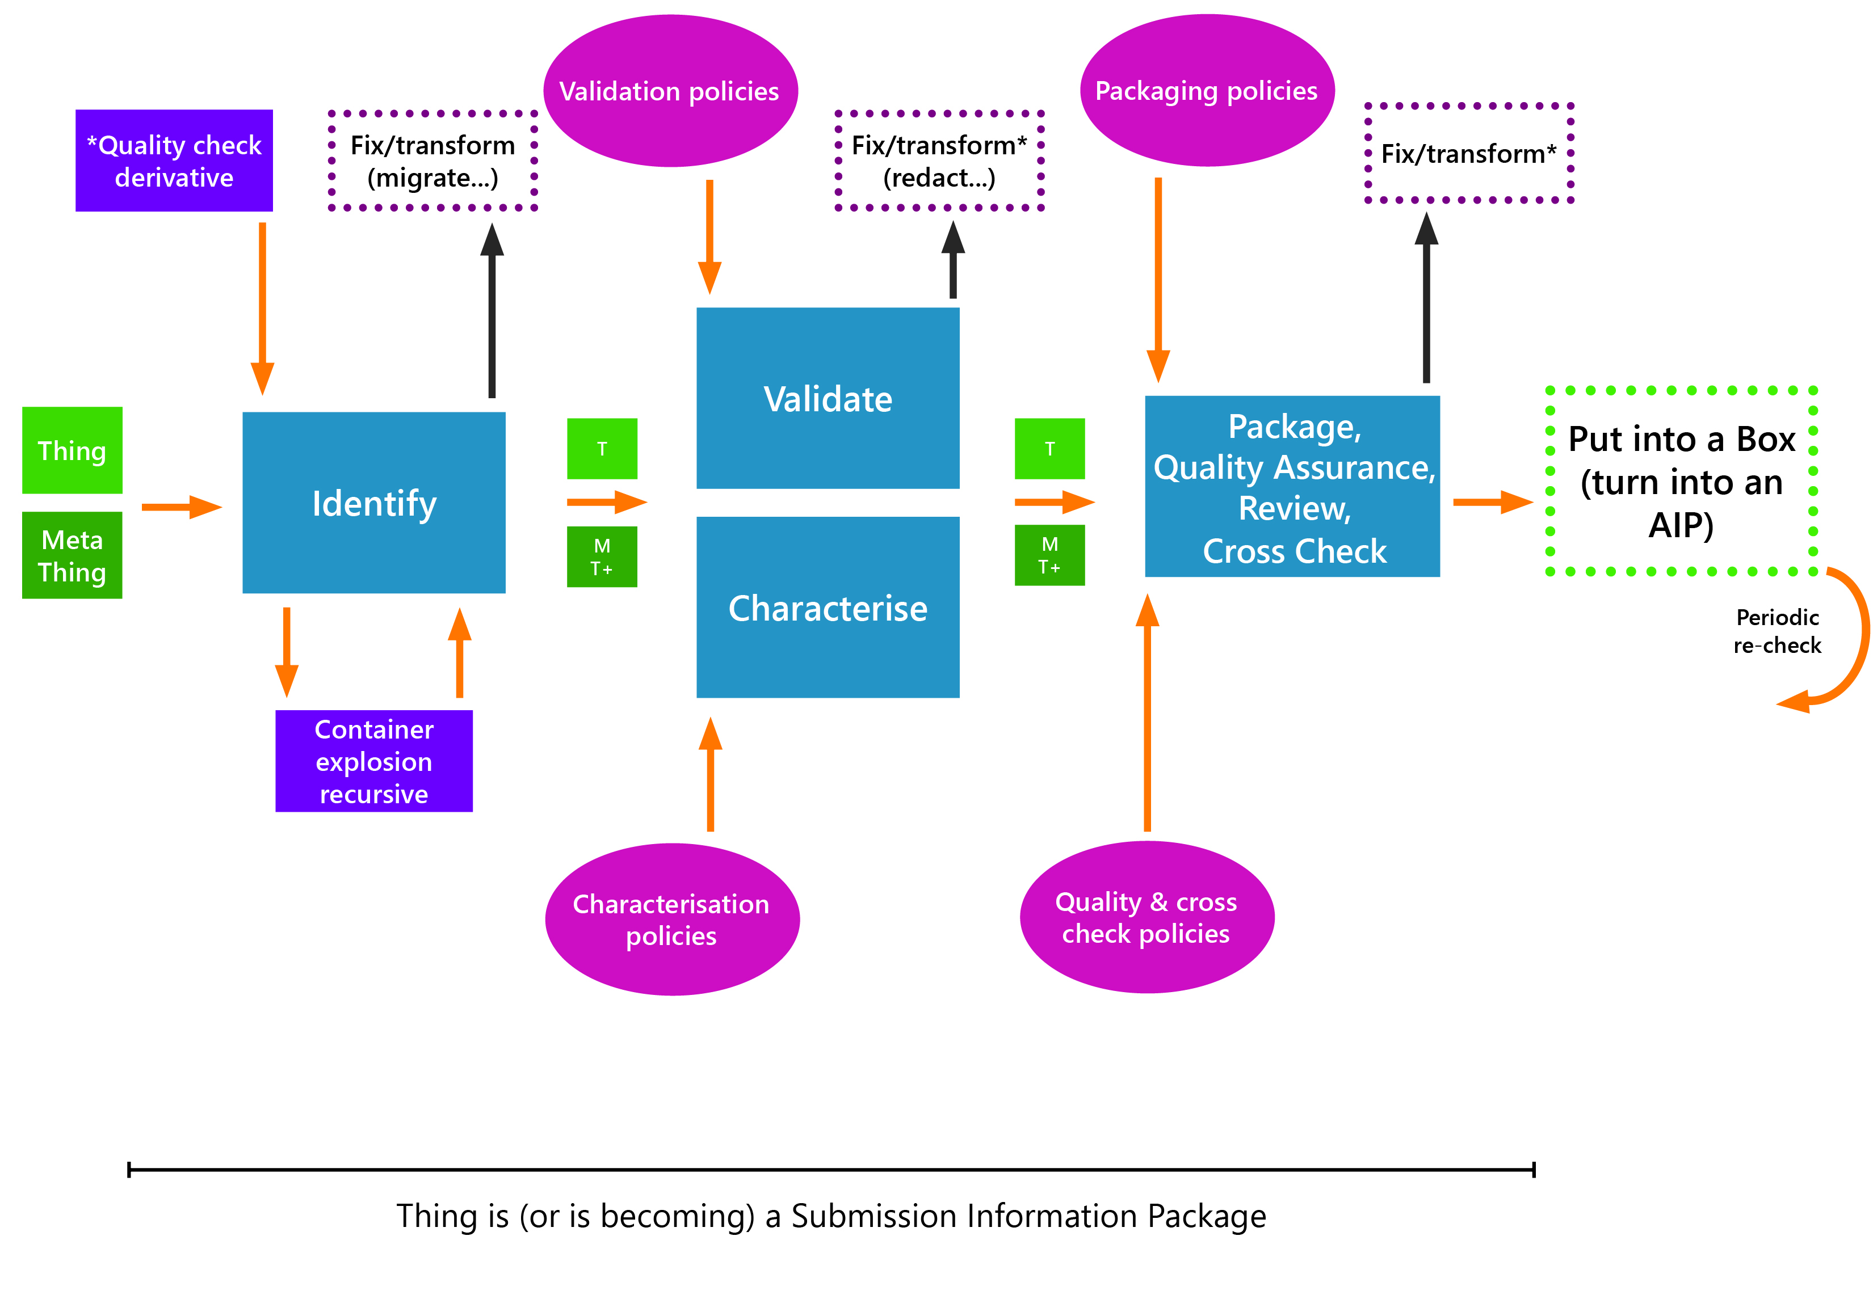
OPF Reference Toolset – generic process

Slide 9




OPF Tool Mapping
Transform
Database archiving / Extraction tools
Recommended by OPF
SIARD (SQL database to XML format)
Derivative check tools
Maintained through OPF
xcorrsound
WAV, MP3
Validation
polices
Packaging polices
*Quality check derivative
Fix/transform
(migrate…)
Fix/transform*
(redact…)
Fix/transform*
Validate
Package,
Quality Assurance,
Review,
Cross Check
Thing
Identify
T
T
Put into a Box (turn into an AIP)
Meta
Thing
M
T+
Characterise
M
T+
Periodic
re-check
Disk image explosion/analysis
Recommended by OPF
Container explosion recursive
Characterisation polices
Quality & Cross Check polices
Identification tools
Maintained through OPF
Format Sniff
Recommended by OPF
DROID
PRONOM
FILE
Validation and Characterisation tools
Maintained through OPF
(DPF Manager)
TIFF module
Information Packaging tools
TBA
Quality check tools
E-ARK CEF SIP validator
PDF/A
PDF, JPEG, WAV, PNG, WARC, AIFF, UTF8 TEXT, XML, HTML, GZIP, ASCII TEXT, MP3, GIF, JPEG2000
TIFF
JPEG2000
Cross Check tools
TBA

Slide 10




How do OPF projects work?
FUNDING
OPF membership
Donations
Project income
PLANNING (PRODUCT BOARD)
Prioritise fixes and features
Define the release
Manage the roadmap
DEVELOPMENT & TESTING
GitHub for OS development
Build a set of test data
Continuous integration
Quality Assurance
REQUIREMENTS & COMMUNITY FEEDBACK
Bug reports and new feature requests
Hack day activities
Code contributions
Input from OPF interest groups
Contribution of test files
Improvements to documentation
FINAL TEST & RELEASE
Production release
Freely available to community
Patches (essential fixes)

Slide 11
Preservation Action Registry

Slide 12
PAR Background: The problem
Users want the best advice, wherever it comes from
Identification, property extraction, validation, migration, rendering, tools
Many sources for current ‘best practice’
Products such as Preservica & Archivematica
Practitioners
Academics
Specialists
- but they don’t talk to each other effectively

Slide 13
Background: Motivation and Objectives
To provide a mechanism to exchange good practice information between organisations and preservation system suppliers regardless of which system they use.
Explicitly: To provide compatibility/ interoperability between JISC RDSS project systems.
However:
It is not a single ‘Best Practice’
It is not ‘one registry to rule them all’

Slide 14
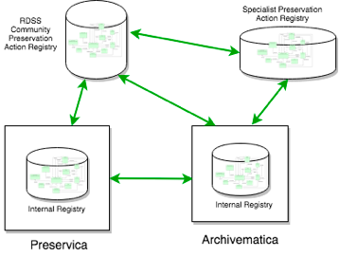

Background: Jisc RDSS Project
Development of a multi-vendor shared services platform led to discussions of interoperability of format policies (i.e. “preservation actions”) between preservation systems.
FPR
Notes:
Current digital preservation systems such as Archivematica and Preservica lack a common and consistent way to describe and execute preservation policies and actions at a technical level. Archivematica’s Format Policy Register (FPR) and Preservica’s Linked Data Registry (LDR) both define what tools and rules to use when doing digital preservation and whilst these two approaches aim to solve similar problems, they are not interoperable.
There is no way to share technical information between the two solutions and for users to share their experience on what approaches to use in different contexts and why. This hinders implementation and execution of digital preservation in an interoperable way within the digital preservation community.
Preservation Action Registries (PAR) could be used to capture and share technical best practice for the preservation of digital objects in the form of a corpus of machine-readable recommendations. The registry’s data model defines what tools can be used for different digital object formats, what properties can be extracted or measured and what preservation actions can be taken. The model includes contextual and historical information on the reasons why recommendations are being given. The information is versioned and includes the tool parameters and software environments needed to execute different preservation actions so they are directly ‘executable’ by preservation systems.

Slide 15
Background: Project Conception
A JISC funded project to initiate the process to deliver benefits to RDSS users
Arkivum, Preservica and Artefactual as RDSS product suppliers
Open Preservation Foundation as respected independent shared DP technology supplier
Notes:
1st round of work in Fall 2017: Conceptual Model
2nd round in Winter 2018: paper accepted at iPres
3rd round Summer 2018: implement a proof of concept

Slide 16



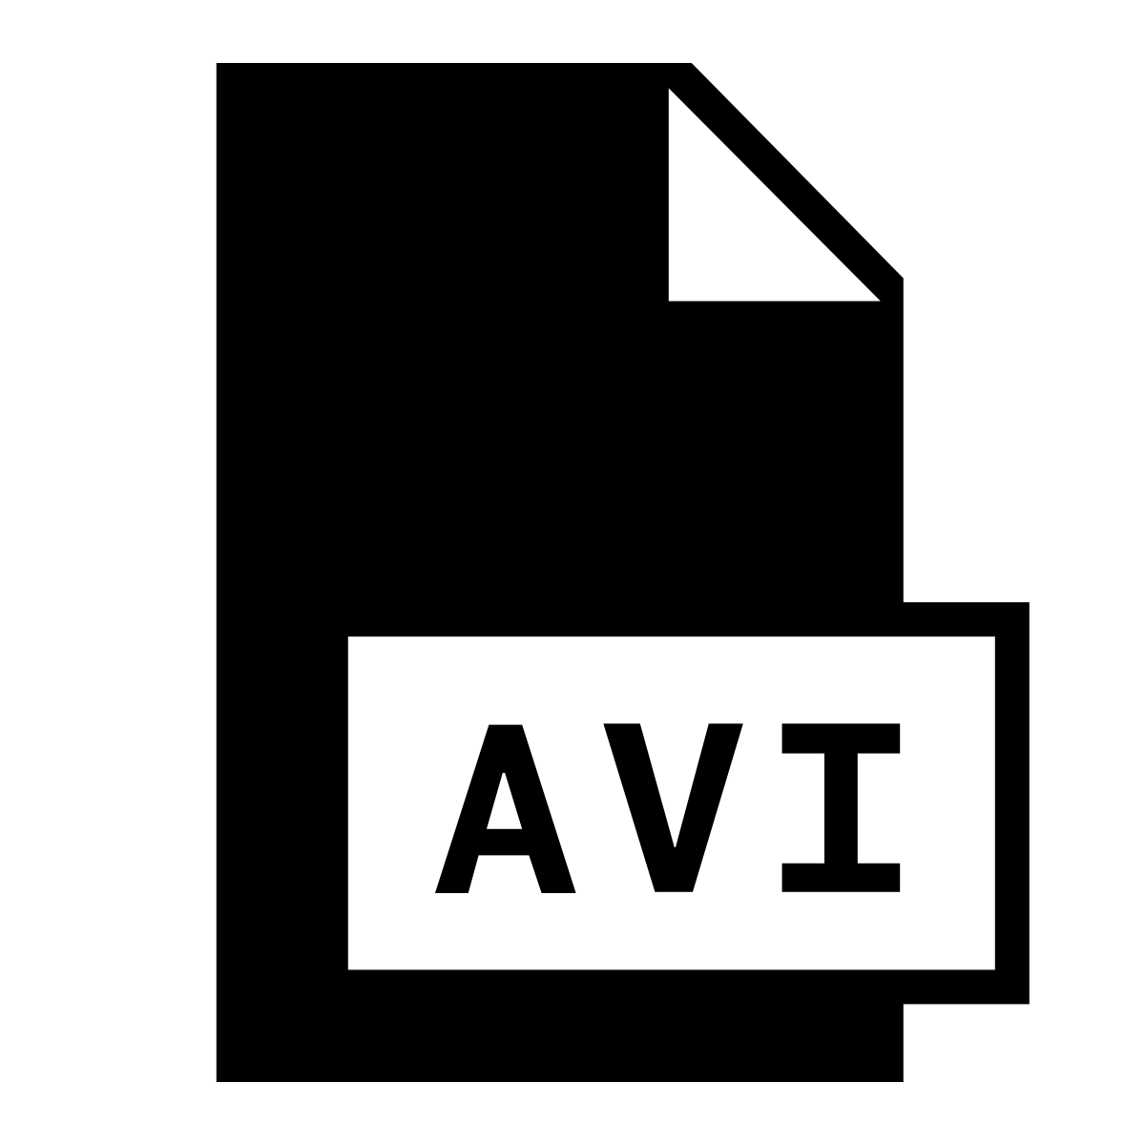
Digital Preservation Actions
Preservation is not just about file formats, it’s about making sense of data
The specific action depends on the context, and the policies. – what action is being taken and why? What is the business rule?
Today - preservation actions are not portable across systems (e.g. A rchivematica, Preservica, others)
includes
requires
research dataset object
preservation actions
Bunch of files
From research dept
Convert to desired format

Slide 17
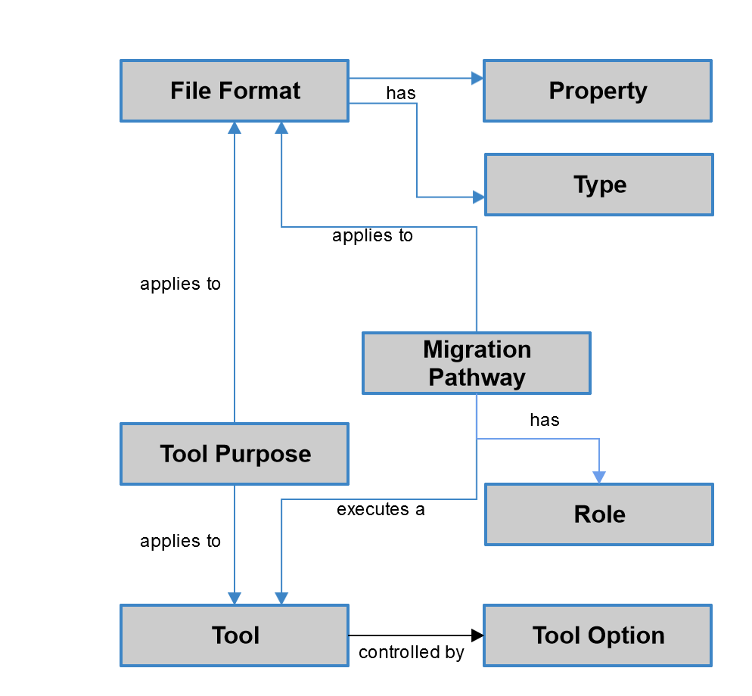
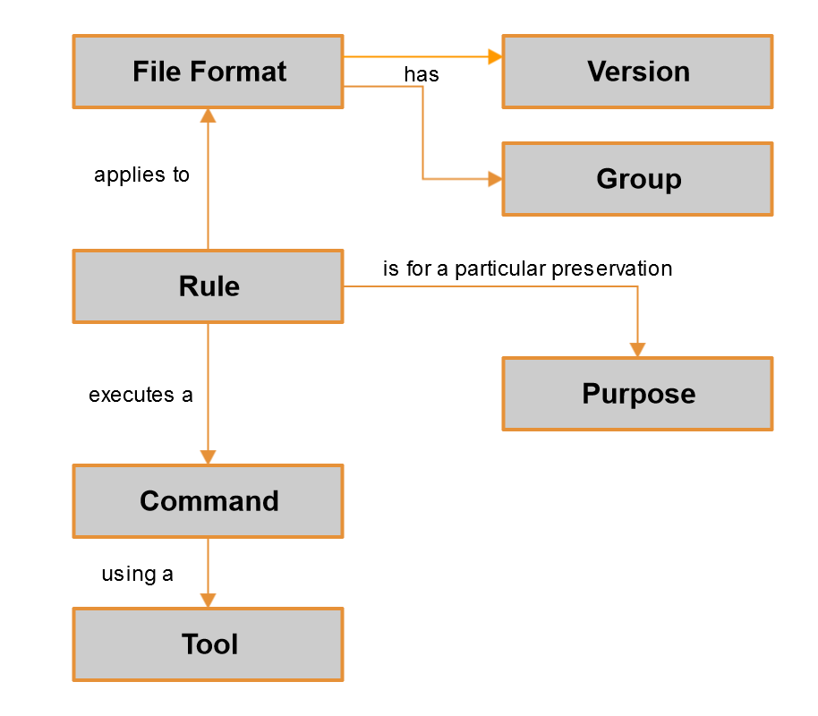
Current Registry (In)compatibility
Preservica Registry
Archivematica FPR
?
Notes:
Archivematica and Preservica both perform a number of preservation activities, and both are controlled by data from technical registries. However, as these simplified models show, the way the two systems describe how this works is very different. Some things are “obviously” similar, like File Format, some things look like they should be similar, like Tools, but actually aren’t. So to solve Jisc’s case, we could have worked out the mapping between these two systems, then added functionality in each so that a Preservica user could export something use from the Registry into an Archivematica FPR format, and vice-versa.
But this would have:
1) been limited to these two systems,
2) meant that internal changes in one system would have had to been known, understood and actioned in the other, and most importantly,
3) missed an opportunity to provide a more widely sharable description.

Slide 18
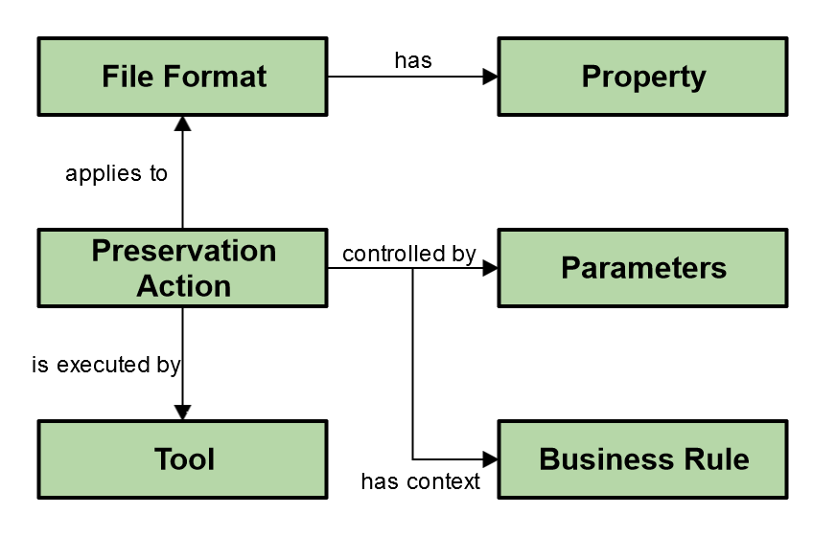
Common Language
?
?
Notes:
So now, we only need to determine internally how each system maps to the PAR model, which is a similar sized problem as we had before. However, in this model internal changes in Preservica or Archivematica are isolated, as they were before. And anybody else who has a registry to describe preservation actions can also map to the PAR model and share the same knowledge. And even if you don’t have a registry, as long as you can “speak the common PAR language” in order to describe the action you perform, you can make that available to users of multiple different systems.

Slide 19
What have we produced and why?
Conceptual Model | Common framework for everyone Language between preservation systems Still under definition…
Json Schemas | Formal definition of the conceptual model Machine readable, used in API payloads Used to test and validate interoperability
API | Common interface for preservation systems Well defined way to exchange information
Executable Digital Preservation Actions | Cross-platform way to deploy/run tools Unambiguous and vendor independent
Proof of Concept | Reference implementation to share Make the idea really work between Preservica and Archivematica
Notes:
Matthew

Slide 20
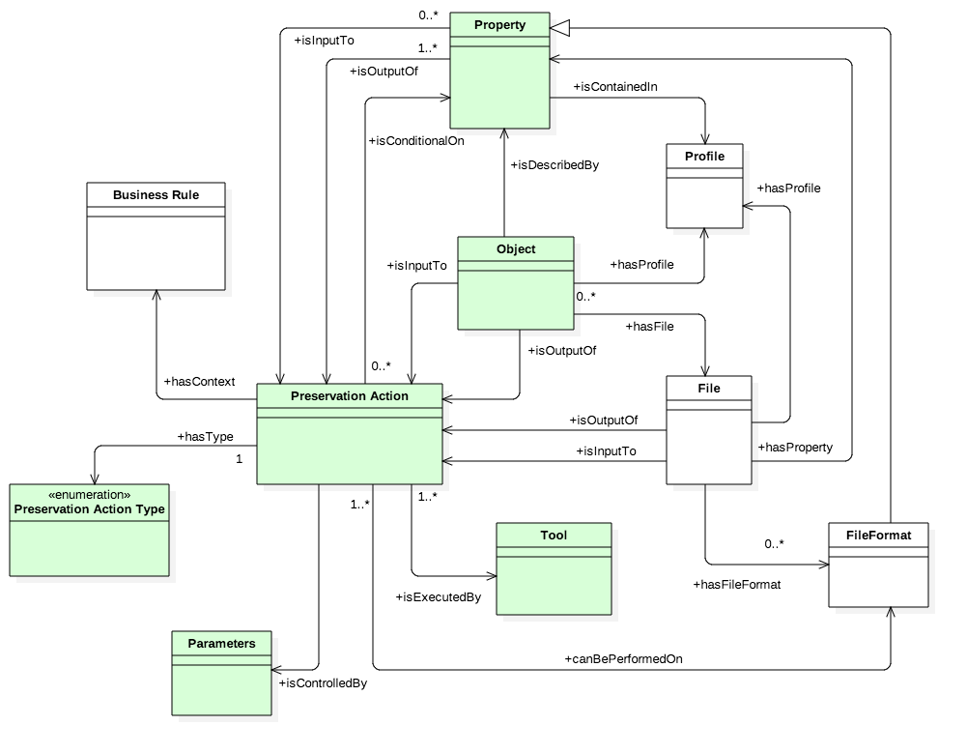
PAR Conceptual Model
Notes:
We started talking about what it actually was we were trying to describe, and came up with an overall conceptual model that looks something like this.

Slide 21
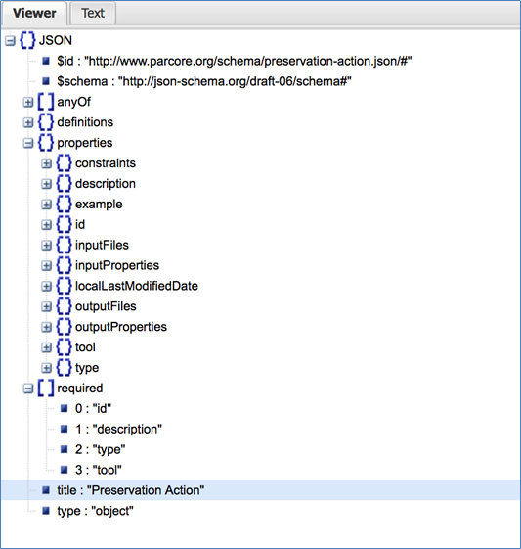
JSON schemas
Tool
Action
Action Type
Format
Property
Business Rule

Slide 22
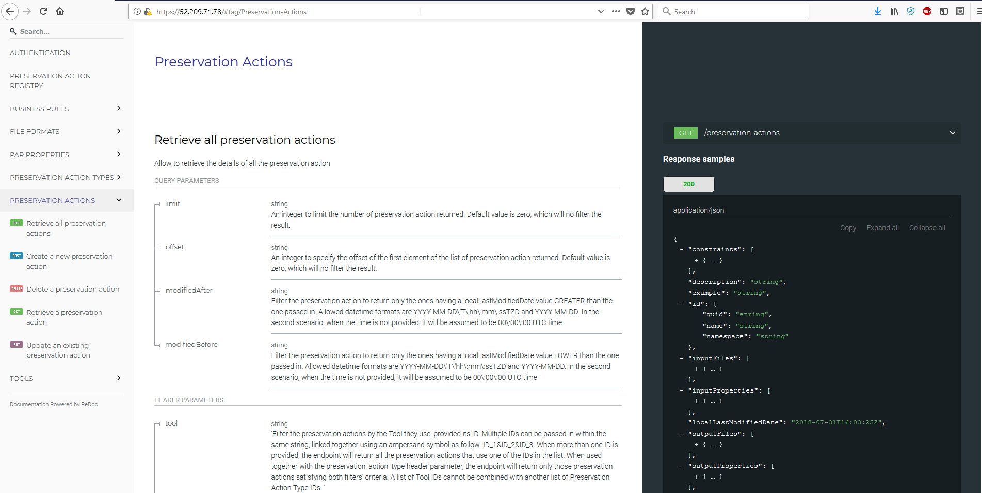
APIs
https://github.com/JiscRDSS/rdss-par/tree/master/api

Slide 23

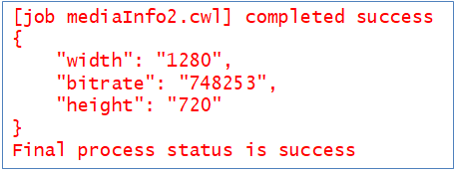
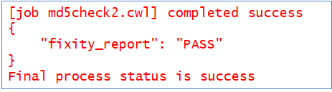
Executable Tool Definitions
Machine readable spec for running a tool
Tool command line
Parameters and flags
Inputs and outputs
Pre and post processing
Fixity check
Property extraction

Slide 24
Next steps
OPF coordination
Define project deliverables and stages in more detail
More use cases demonstrating real benefits
Looking for more organisations to be involved
Extend the conceptual model to more practical cases that involve more organisations
Make PAR useful to communicate good practice between systems and organisations

Slide 25




Join OPF today!
For more information get in touch…
martin.wrigley@openpreservation.org
http://openpreservation.org/
https://github.com/openpreserve
@openpreserve
Newsletter: www.openpreservation.org/subscribe/
For more info on PAR go to
www.openpreservation.org/about/projects/par

